Slide 1
☸ KUBERNETES | KT DAY 1
Kubernetes Storage
Docker
Kubernetes
Volumes · PV · PVC · Storage Class
Prometheus & Grafana
YAML
Prometheus
Internal Knowledge Transfer — Series 1
Date: 14 May 2026
Grafana

Slide 2
Introduction
About This Session
Prerequisites
Day 1: Volumes & Storage Architecture
Day 2: PV, PVC & Storage Classes
Day 3: Prometheus & Grafana Monitoring
Hands-on YAML demos every session
Q&A at end of each module
Basic Linux command line knowledge
Docker fundamentals (containers, images)
Kubernetes Pods & Deployments basics
kubectl CLI installed & configured
Access to demo cluster (shared creds)
Kubernetes Storage KT — Day 1 | Internal Training

Slide 3
Agenda — Day 1 KT
01
What is YAML?
05
Volume Types Deep Dive
02
What is a Volume?
06
emptyDir · hostPath · ConfigMap · Secrets · NFS · CSI
03
Why Do We Need Volumes?
07
Hands-On Demo Setup
04
Kubernetes Storage Architecture
08
Q&A / Wrap-Up
Kubernetes Storage KT — Day 1 | Internal Training

Slide 4
What is YAML?
YAML Ain't Markup Language — Human-readable data serialization format
Key Concepts
Sample YAML — Pod Manifest
Indentation-based structure (2 spaces, no tabs)
Key-value pairs at the core of every manifest
Supports lists (- item) and nested maps
Used for ALL Kubernetes resource definitions
Comments start with # — ignored by parser
Three main document sections:
apiVersion — K8s API group & version
metadata — Name, namespace, labels
spec — Desired state of the resource
apiVersion: v1
kind: Pod
metadata:
name: my-app
namespace: default
labels:
app: my-app
env: dev
spec:
containers:
- name: app-container
image: nginx:latest
ports:
- containerPort: 80
volumeMounts:
- mountPath: /data
name: my-vol
volumes:
- name: my-vol
emptyDir: {}
Kubernetes Storage KT — Day 1 | Internal Training

Slide 5
What is a Volume?
Kubernetes provides volumes to solve the ephemeral container filesystem problem
💡 Think of a Volume as an external USB drive plugged into a container — data survives container restarts and can be shared between containers in the same Pod.
Container Filesystem
Volume in Kubernetes
Volume vs Docker Volume
By default, a container's filesystem is temporary. Any data written inside a container is lost when the container crashes or restarts — just like clearing your browser cache.
A Volume is a directory accessible to containers in a Pod. It exists beyond the lifetime of individual containers. It is declared in the Pod spec and mounted into one or more containers.
Docker volumes are loosely managed. K8s volumes are declared explicitly in the Pod spec, support many backend types (disk, NFS, cloud), and integrate with the full K8s lifecycle.
Kubernetes Storage KT — Day 1 | Internal Training

Slide 6
Why Do We Need Volumes?
📦 Data Persistence
🔄 Data Sharing
⚙️ Configuration Injection
Containers are ephemeral — when a container dies, so does its data. Volumes keep data alive across restarts, upgrades, and rescheduling events.
Multiple containers inside the same Pod can read & write a shared Volume (e.g., a log writer + log shipper sidecar pattern).
ConfigMaps and Secrets are mounted as volumes, decoupling config from container images. Change config without rebuilding the image.
🗄️ Stateful Workloads
☁️ Cloud-Native Storage
🔒 Security & Compliance
Databases (MySQL, PostgreSQL, Redis), message queues (Kafka), and file servers all need durable storage — volumes enable these in K8s.
Volumes abstract the underlying storage — AWS EBS, Azure Disk, GCS, NFS — behind a consistent Kubernetes API.
Sensitive data (TLS certs, API keys) stored in Secrets volumes is base64-encoded, access-controlled via RBAC, and never baked into images.
Kubernetes Storage KT — Day 1 | Internal Training

Slide 7
Kubernetes Storage Architecture
Application Pod
Containers with volumeMounts
▼
PersistentVolumeClaim (PVC)
User request for storage (namespace-scoped)
▼
PersistentVolume (PV)
Cluster-wide storage resource
▼
StorageClass
Dynamic provisioner + reclaim policy
▼
Backend Storage
NFS · AWS EBS · GCE PD · Azure Disk · Ceph
🔑 Key: PVC binds to PV → StorageClass provisions PV dynamically → CSI driver talks to backend

Slide 8
Volume Types in Kubernetes
K8s supports 25+ volume types — we cover the most common in this session
emptyDir
Ephemeral
hostPath
Node-local
configMap
K8s Object
Temporary scratch space, lives with the Pod
Mount a file/dir from the host node filesystem
Inject config data into container as files
secret
K8s Object
nfs
Network
csi
Plugin
Mount sensitive data (passwords, tokens) safely
Mount an NFS share across multiple pods
Container Storage Interface — extensible drivers
Kubernetes Storage KT — Day 1 | Internal Training

Slide 9
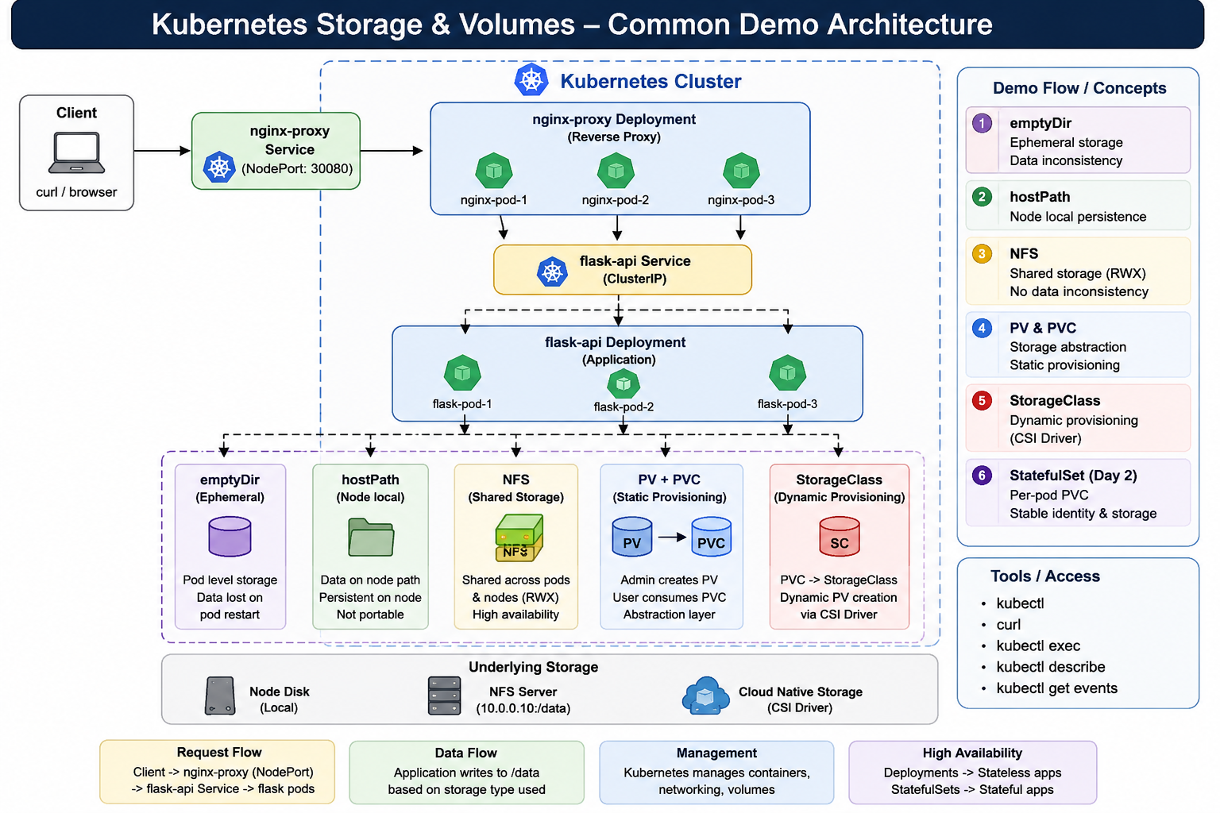
My Demo Environment Setup
Local Kubernetes cluster used for all demos in this KT series
Cluster
K8s Version
Container RT
Storage Plugin
KubeAdm
v1.29.x
Containerd
NFS + hostPath (local demo)
Kubernetes Storage KT — Day 1 | Internal Training

Slide 10
emptyDir Volume
Overview & Characteristics
YAML Example
Created fresh (empty) when Pod is assigned to a node
Deleted permanently when the Pod is removed
All containers in a Pod share the same emptyDir
Default medium: node's disk (or RAM using memory)
Use Cases:
Scratch space for temp computation
Shared working dir between sidecar containers
Cache that can be rebuilt on Pod restart
⚠️ Not for permanent data — lost on Pod deletion
apiVersion: v1
kind: Pod
metadata:
name: emptydir-demo
spec:
containers:
- name: writer
image: busybox
command: ["sh","-c",
"echo Hi>/cache/data.txt;sleep 3600"]
volumeMounts:
- mountPath: /cache
name: scratch-vol
- name: reader
image: busybox
command: ["sh","-c",
"cat /cache/data.txt; sleep 3600"]
volumeMounts:
- mountPath: /cache
name: scratch-vol
volumes:
- name: scratch-vol
emptyDir: {}
# RAM-backed emptyDir:
# emptyDir:
# medium: Memory
# sizeLimit: 256Mi
Kubernetes Storage KT — Day 1 | Internal Training

Slide 11
hostPath Volume
Overview & Characteristics
YAML Example
Mounts a file or directory from the host node's filesystem
Data persists as long as the node exists (not tied to Pod)
Survives Pod deletion — data remains on the node
Only accessible on the SAME node where Pod runs
Use Cases:
Access Docker socket (/var/run/docker.sock)
Node monitoring (access /proc, /sys)
Development & debugging on a single node
⚠️ Security risk — exposes host filesystem to Pod
⚠️ Not suitable for multi-node production use
apiVersion: v1
kind: Pod
metadata:
name: hostpath-demo
spec:
containers:
- name: app
image: nginx:alpine
volumeMounts:
- mountPath: /host-data
name: host-vol
- mountPath: /var/run/docker.sock
name: docker-sock
volumes:
- name: host-vol
hostPath:
path: /data/myapp # host path
type: DirectoryOrCreate
- name: docker-sock
hostPath:
path: /var/run/docker.sock
type: Socket
# hostPath types:
# DirectoryOrCreate File Socket
# BlockDevice CharDevice FileOrCreate
Kubernetes Storage KT — Day 1 | Internal Training

Slide 12
ConfigMap Volume
Overview & Characteristics
YAML Example
Stores non-sensitive config data as key-value pairs
Decouples config from container image — 12-factor app
Can be mounted as files OR injected as env variables
Each key becomes a file; value becomes file content
Changes to ConfigMap can be auto-refreshed in pods
Use Cases:
App config files (nginx.conf, app.properties)
Feature flags, environment settings
Mounting entrypoint scripts into containers
Max size: 1 MiB per ConfigMap
# Step 1: Create ConfigMap
apiVersion: v1
kind: ConfigMap
metadata:
name: app-config
data:
app.properties: |
server.port=8080
log.level=INFO
nginx.conf: |
server { listen 80; }
---
# Step 2: Mount in Pod
apiVersion: v1
kind: Pod
metadata:
name: configmap-demo
spec:
containers:
- name: app
image: myapp:latest
volumeMounts:
- mountPath: /etc/config
name: config-vol
volumes:
- name: config-vol
configMap:
name: app-config
Kubernetes Storage KT — Day 1 | Internal Training

Slide 13
Secrets Volume
Overview & Characteristics
YAML Example
Similar to ConfigMap but designed for SENSITIVE data
Values are Base64-encoded (not encrypted by default)
Stored in etcd — enable encryption-at-rest in production
Mounted as files (tmpfs — memory backed, not on disk)
Access controlled via Kubernetes RBAC
Types of Secrets:
Opaque — generic key-value
kubernetes.io/tls — TLS certificate & key
kubernetes.io/dockerconfigjson — registry creds
⚠️ Base64 is NOT encryption — secure etcd separately
# Step 1: Create Secret
apiVersion: v1
kind: Secret
metadata:
name: db-secret
type: Opaque
data:
# echo -n 'mypassword' | base64
db-password: bXlwYXNzd29yZA==
db-user: YWRtaW4=
---
# Step 2: Mount as Volume
apiVersion: v1
kind: Pod
metadata:
name: secrets-demo
spec:
containers:
- name: app
image: myapp:latest
volumeMounts:
- mountPath: /etc/secrets
name: secret-vol
readOnly: true
volumes:
- name: secret-vol
secret:
secretName: db-secret
defaultMode: 0400
Kubernetes Storage KT — Day 1 | Internal Training

Slide 14
NFS Volume
Overview & Characteristics
YAML Example
Network File System — mount a remote NFS share into Pod
Data is stored on the NFS server, not the node
Survives Pod and even node failures
Supports ReadWriteMany (RWX) — multiple pods can write
NFS server can be inside or outside the cluster
Use Cases:
Shared media/uploads across multiple replicas
Legacy systems already using NFS infrastructure
Simple multi-pod read/write shared storage
⚠️ NFS server is a single point of failure
⚠️ Performance limited by network bandwidth
# Direct NFS Volume in Pod
apiVersion: v1
kind: Pod
metadata:
name: nfs-demo
spec:
containers:
- name: app
image: nginx:alpine
volumeMounts:
- mountPath: /mnt/shared
name: nfs-vol
volumes:
- name: nfs-vol
nfs:
server: 192.168.1.100 # NFS server IP
path: /exports/shared # exported path
readOnly: false
---
# Better approach: NFS via PersistentVolume
apiVersion: v1
kind: PersistentVolume
metadata:
name: nfs-pv
spec:
capacity:
storage: 10Gi
accessModes: [ReadWriteMany]
nfs:
server: 192.168.1.100
path: /exports/shared
Kubernetes Storage KT — Day 1 | Internal Training

Slide 15
CSI — Container Storage Interface
Overview & Characteristics
YAML Example (AWS EBS CSI)
Industry standard plugin interface for storage vendors
Replaces deprecated in-tree plugins (FlexVolume, etc.)
Vendor-specific drivers deployed independently of K8s
Supports snapshots, cloning, expansion & topology
Popular CSI Drivers:
AWS EBS CSI, Azure Disk CSI, GCE PD CSI
Rook-Ceph, Longhorn, OpenEBS, Portworx
NFS CSI Driver (kubernetes-csi/csi-driver-nfs)
Works with StorageClass for dynamic provisioning
✅ Recommended for all production environments
# StorageClass using CSI Driver
apiVersion: storage.k8s.io/v1
kind: StorageClass
metadata:
name: ebs-sc
provisioner: ebs.csi.aws.com
volumeBindingMode: WaitForFirstConsumer
parameters:
type: gp3
encrypted: "true"
---
# PVC using the StorageClass
apiVersion: v1
kind: PersistentVolumeClaim
metadata:
name: ebs-claim
spec:
accessModes: [ReadWriteOnce]
storageClassName: ebs-sc
resources:
requests:
storage: 20Gi
---
# Pod using the PVC
volumes:
- name: ebs-vol
persistentVolumeClaim:
claimName: ebs-claim
Kubernetes Storage KT — Day 1 | Internal Training

Slide 16
Demo Section — Hands-On
D1
emptyDir — Shared Cache
D2
hostPath — Node Data
kubectl apply –f <yaml >
kubectl exec -it <pod>-n <ns> -- sh
cat /data/items.json
mkdir -p /tmp/k8s-demo
kubectl apply -f hostpath-pod.yaml
kubectl exec hostpath-demo -- ls /host-data
# Write on node, see in container
D3
ConfigMap — Config as File
D4
Secret — Sensitive Data
kubectl create configmap app-config \
--from-file=app.properties
kubectl apply -f configmap-pod.yaml
kubectl exec configmap-demo -- \
cat /etc/config/app.properties
kubectl create secret generic db-secret \
--from-literal=db-password=mypass
kubectl apply -f secret-pod.yaml
kubectl exec secrets-demo -- \
cat /etc/secrets/db-password
📌 Full YAML files available in the shared repo: git.internal/k8s-kt-series/day1-volumes

